Slide 1
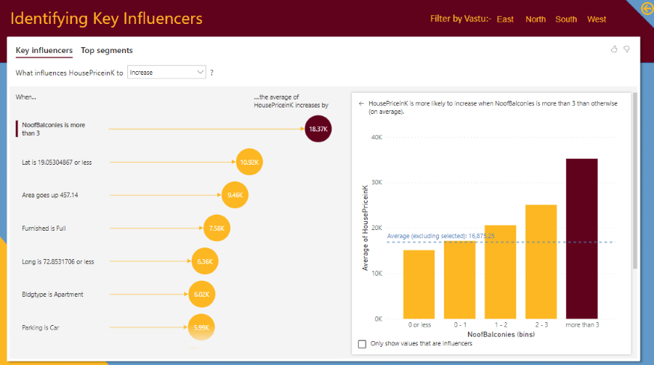
Analyzing Mumbai House price – MS Power BI Project

Slide 2
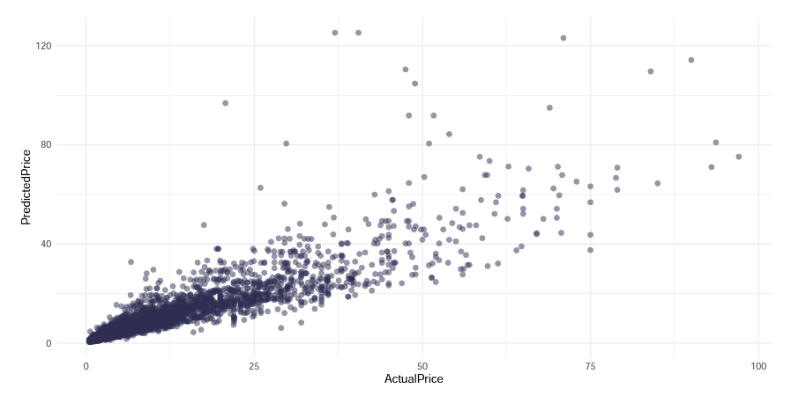
Predict Used Cars Valuation – Data Science Python Project

Slide 3
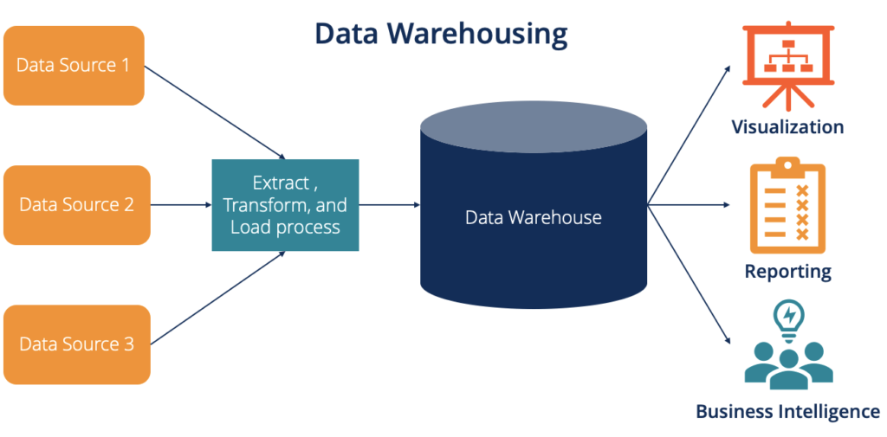
Data Warehouse - SQL, Azure Synapse Analytics, Azure Git, CI CD deployment

Slide 4

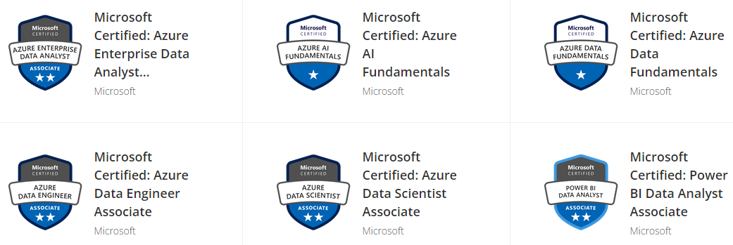
Microsoft Azure Data Certificates

Slide 5
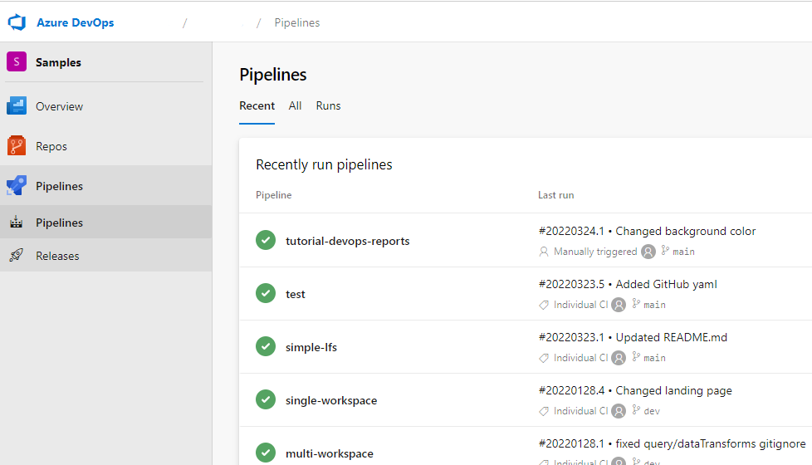
Automation, Git & CI/CD deployment - DataOps project

Slide 6
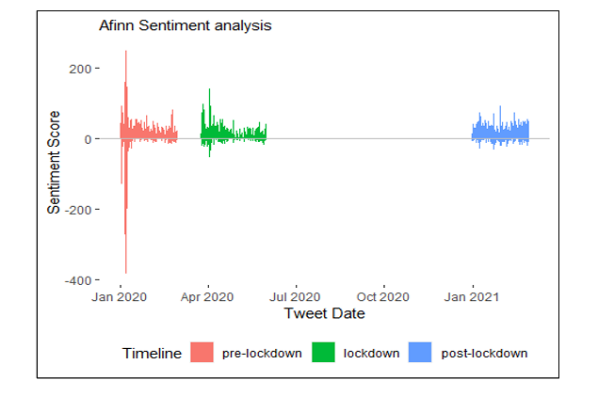
Effect of lockdown on company – Twitter Sentiment Analysis

Slide 7
Effect of lockdown on company – Twitter Sentiment Analysis

